Slide 1
Review 1 FAKE NEWS DECTECTION
Guide:
Sasidhar K
G. Madhukar Rao
Presenters
2010030071 - Jyothin Movva
2010030151 - K S Satyavarsan
2010030040 - Devaraj Acharya
2010030323 - Haneesh M

Slide 2
INDEX
TOPIC-1
TOPIC-2
TOPIC-3
TOPIC-4
TOPIC-5
PROJECT AREA
LITERATURE SURVEY.
PROBLEM STATEMENT
CONCLUSION.
SUGGESTIONS.

Slide 3
Project Area
Social media for news consumption is a double-edged sword. On the one hand, its low cost, easy access, and rapid dissemination of information lead people to seek out and consume news from social media. On the other hand, it enables the wide spread of “fake news”, i.e., low quality news with intentionally false information.
The project is about fake news detection. We are trying to implement this using naïve bayes classifier. In this modern digital world fake news detection is very important . It can be used in many applications. As digital media spreads rapidly, it is important to detect and contain fake news.

Slide 4
Literature survey

Slide 5
S.NO | Authors | Title | Publishing | Pros | Cons
1 | Anjali Jain, Harsh Khatter, Avinash Shakya | A smart system for fake news detection using machine learning | Dr. APJ Abdul Kalam University, Lucknow, India (September 2019) | This covers and compares all different methodologies like SVM, naïve bayes and CNN. | Having many methodologies also makes it difficult to implement
2 | Kelly Stahl | Fake news detection in social media | California State University Stanislaus (15 May 2018) | Uses multiple methodologies like naïve bayes, SVM and semantic analysis | SVM and Naïve Bayes classifier tend to “rival” each other due to the fact they are both supervised learning algorithms that are efficient at classifying data.

Slide 6
S.NO | Authors | Title | Publishing | Pros | Cons
3 | Monther Aldwairi, Ali Alwahedi | Detecting Fake News in Social Media Networks | College of Technological Innovation, Zayed University, Abu Dhabi 144534, UAE (2018) | Natural Language Processing (NLP) techniques have been used for news outlet stance detection to facilitate fake news detection on certain issues | Majorly concentrates on click baits rather than the content itself
4 | M. F. Mridha; Ashfia Jannat Keya; Md. Abdul Hamid; Muhammad Mostafa Monowar; Md. Saifur Rahman | A Comprehensive Review on Fake News Detection With Deep Learning | 2017 International Conference on Computing, Communication and Automation (ICCCA) | Uses deep learning | As it uses deep learning it is more complicated to implement

Slide 7
S.NO | Authors | Title | Publishing | Pros | Cons
5 | Kai Shu , Amy Sliva, Suhang Wang , Jiliang Tang , and Huan Liu | Fake News Detection on Social Media: A Data Mining Perspective | Computer Science & Engineering, Arizona State University, Tempe, AZ, USA Charles River Analytics, Cambridge, MA, USA Computer Science & Engineering, Michigan State University, East Lansing, MI, USA (3 sep 2017) | Was tested on multiple datasets like BuzzFeed News, LIAR, BS Detector and CREDBANK | Focuses more on social media news rather than traditional news articles

Slide 8
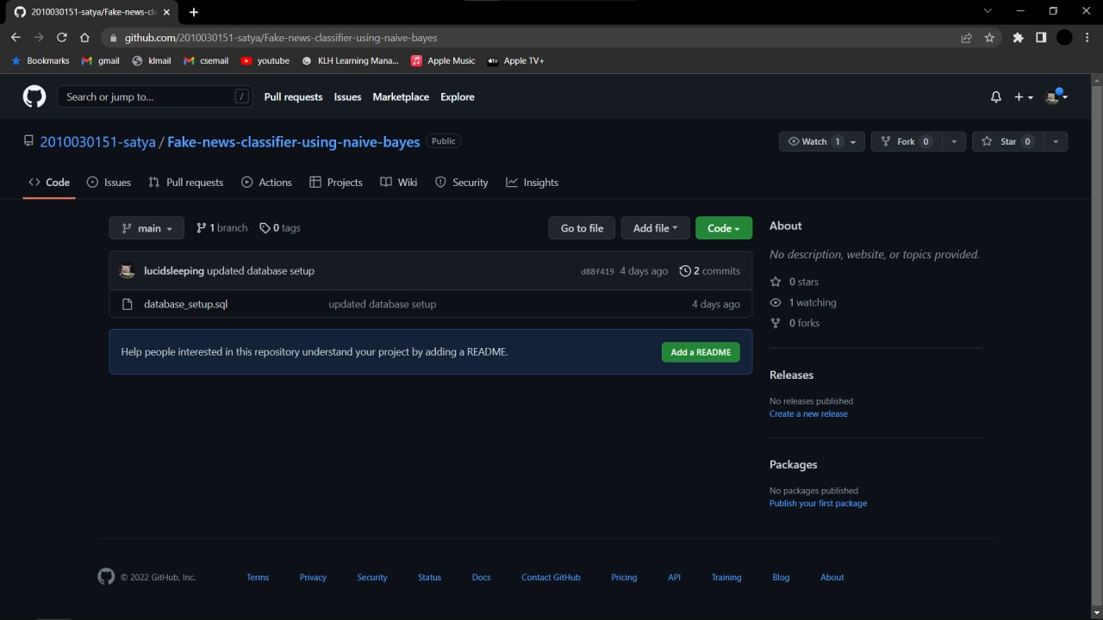
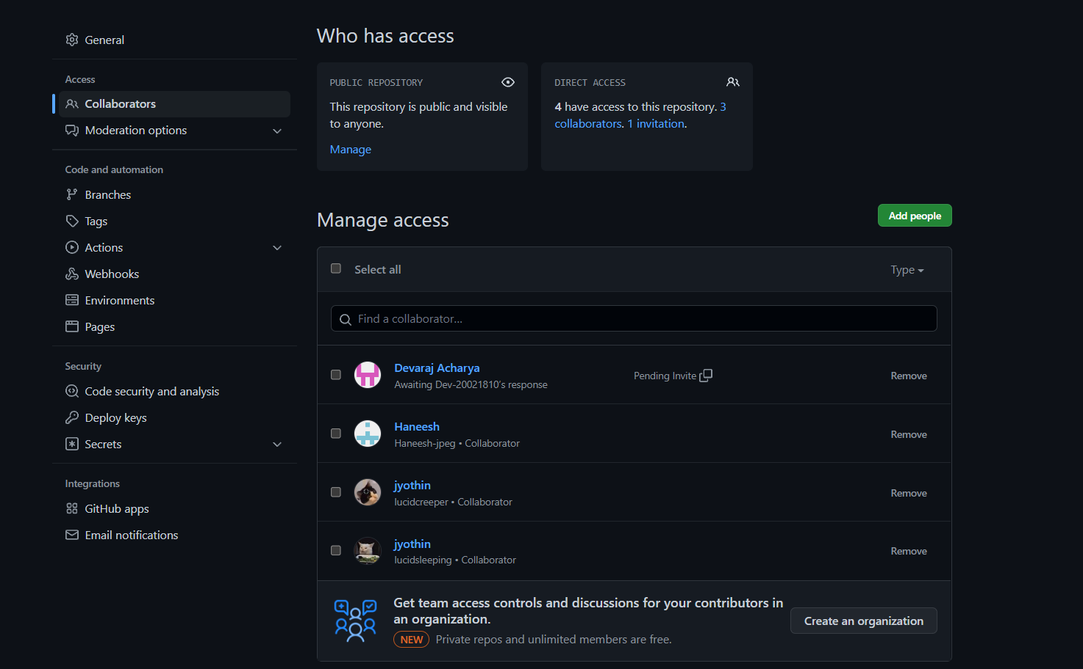
GitHub setup

Slide 9
Work allocation
Haneesh - Data set collection and implementation
Satyavarsan - Front End Development
Jyothin - Back end logic design
Devaraj – Web Design and Documentation

Slide 10
Dataset & tools setup
News Category Dataset -https://www.kaggle.com/datasets/rmisra/news-category-dataset
FakeNewsChallenge -https://github.com/FakeNewsChallenge/fnc-1
LIAR -https://paperswithcode.com/dataset/liar
Java , Python
Eclipse
Visual code studio
Servlets

Slide 11
Problem Statement
Fake news detection using naïve bayes classifier

Slide 12
Conclusion
The spread of fake news and misinformation is causing serious problems to society. Fake news and hoaxes have been there since before the advent of the Internet. The widely accepted definition of Internet fake news is: fictitious articles deliberately fabricated to deceive readers”. Social media and news outlets publish fake news to increase readership or as part of psychological warfare and we intend to reduce this with our project.

Slide 13
Suggestions

Slide 14
Thank you

